Slide 1
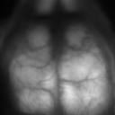
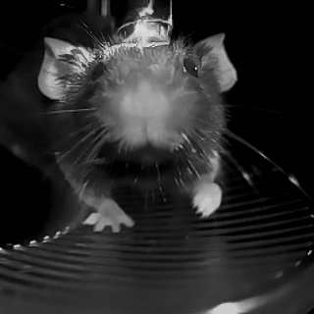
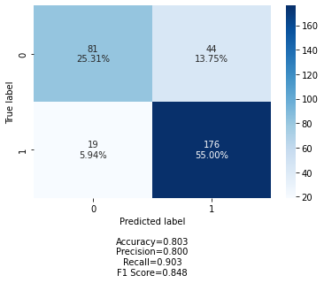
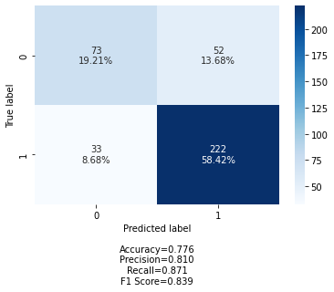
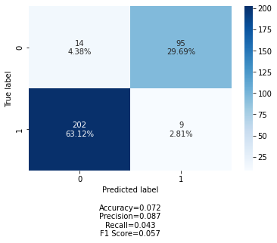
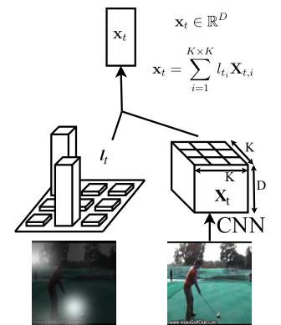
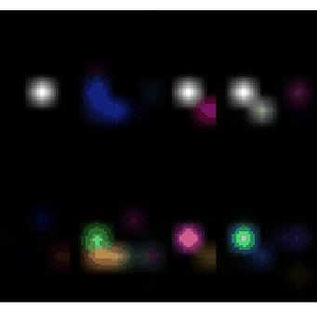




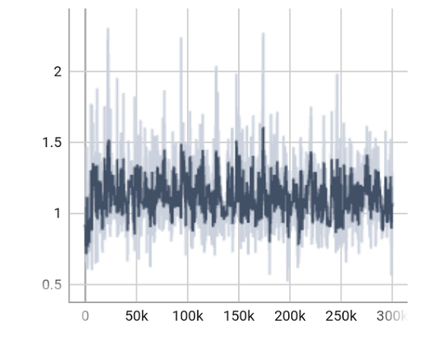
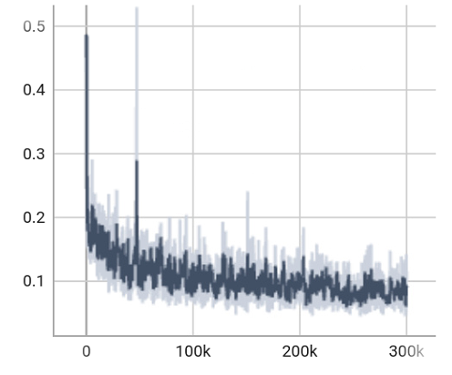
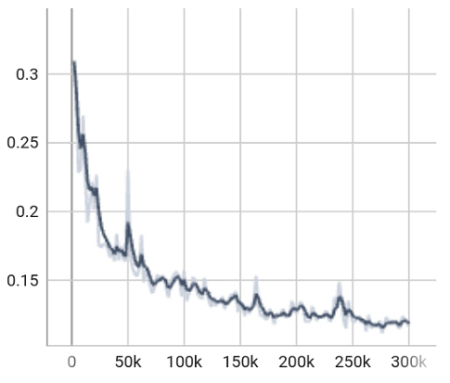



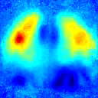



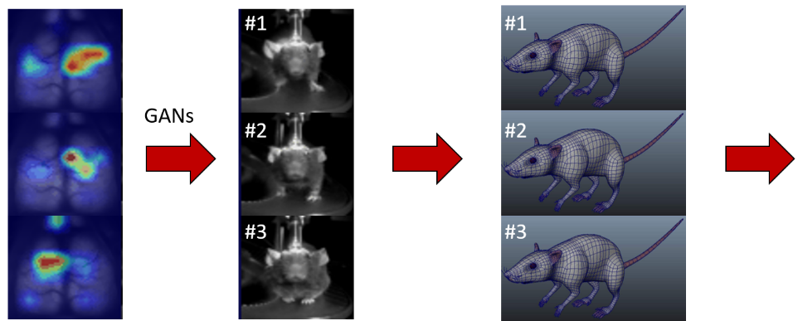

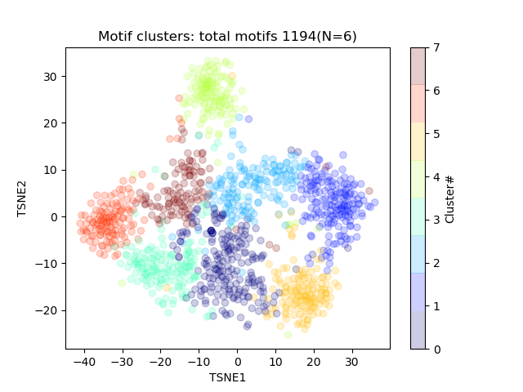








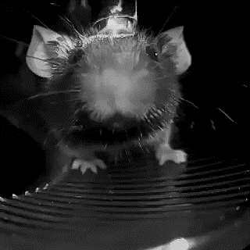


University of British Columbia, Department of Psychiatry, Kinsmen Laboratory of Neurological Research.
MesoGAN: behavior generation from neural decoding of mesoscale cortical calcium dynamics using Generative Adversarial Networks.
Dongsheng Xiao, Bo Zhao and Timothy H. Murphy
Introduction:
A cardinal objective in systems neuroscience entails elucidating the intricate relationship between neural activity and behavior. Historically, behavioral analysis has predominantly focused on low-dimensional, task-associated variables such as locomotion velocity or reaction times. However, burgeoning interest in the complex, nonlinear associations between brain function and high-dimensional behavioral data necessitates the development of innovative tools proficient in decoding real-world, brain-related high-dimensional data. In this study, we present MesoGAN, a sophisticated Generative Adversarial Network (GAN) tailored to synthesize authentic behavioral videos derived from the neural decoding of mesoscopic cortical calcium dynamics. Employing wide-field cortical calcium imaging, our model generates synthetic (predicted) behavioral videos. Our results demonstrate that the GAN-based approach can generate realistic fake behavioral videos that closely resemble the actual videos (brain to behavior). The framework can also be used to reconstruct brain activity from behavior video (behavior to brain). The attention maps produced by the GAN further pinpoint critical brain activity features that are highly predictive of specific bodily movements, thereby offering novel insights into the neural activity-behavior relationship. This research holds significant implications for fields such as brain-computer interfaces, neuroprosthetics, and personalized medicine. By paving the way for future investigations into brain activity decoding, our study contributes to an enhanced understanding of the human brain and its intricate functions.
Simultaneous wide-field cortical calcium imaging and behavioral recording:
Methods:
Results:
Discussion & conclusion:
MesoGAN has the potential to facilitate future studies that delve deeper into the complex relationship between neural activity and behavior, ultimately paving the way for novel therapeutics.
Acknowledgement:
The authors wish to thank the Michael Smith Foundation for Health Research for supporting the research.
MesoGAN model architecture.
Confusion matrix of behavior prediction accuracy.
Brain sequence
Behavior sequence
Running on the wheel task
Reaching for water task
Brain and behavior not aligned
Generator
Encoder
LSTM (with attention)
Decoder
Time
Time
# precision:
(True positive-TP / [TP + False positive-FP] )
# recall:
( TP / [TP + False negative-FN] )
Attention map
Discriminator
Generating wide-field brain activity from behavior video.
Adversarial loss
Real
Fake
Attention
Fake
Real
Attention
Fake
Real
Attention
Fake
Real
Model training:
Adversarial loss
Reconstruction loss
Test (MSE)
Quantification of generated brain videos using Structural Similarity Index (SSIM) score.
Iterations
Iterations
Iterations
Raw data
Raw data
The generator and discriminator networks compete:
– Discriminator network trains to classify real vs. generated behavior videos, tries to maximize probability of real videos, minimize probability of generated videos.
– Generator network adjust parameters so generated behavior videos fool the discriminator, trains using the gradient of the discriminator network, and backpropagated through the network so samples look more like real behavior videos.
Reaching for water task
Mann-Whitney U test results:
p-value: 3.050726e-111 < 0.0001
Running on the wheel task
Mann-Whitney U test results:
p-value: 6.587548e-09 < 0.0001
Results:
Example generated behavior videos with attention maps overlaid on the brain.
Distribution of SSIM scores
Distribution of SSIM scores
Implications for brain-computer interfaces and representing mouse brain and behavior in a Common Brain-Behavioral Framework.
Attention
Fake
Real
Attention
Fake
Real
Attention
Fake
Real
Brain imaging
Synthetic behavior video
Simulated behavior in 3D model
Behavior clusters
Mesoscopic imaging
Mouse #1
1
MesoGAN
Weight
CCD
Mouse #2
0
530nm
Green LED
Quantification of behavioral category prediction accuracy by human raters.
Blue LED
80.3%
33.5%
Mouse #3
Strobing
Recording window
7.2%
44.1%
References:
1. Xiao, D., Forys, B.J., Vanni, M.P. et al. MesoNet allows automated scaling and segmentation of mouse mesoscale cortical maps using machine learning. Nat Commun 12, 5992 (2021). https://doi.org/10.1038/s41467-021-26255-2.
2. Bolaños, L.A.*, Xiao, D.*, Ford, N.L. et al. A three-dimensional virtual mouse generates synthetic training data for behavioral analysis. Nat Methods 18, 378–381 (2021). https://doi.org/10.1038/s41592-021-01103-9.
Behavior recording

